Slide 1

Manu Benny
Rajesh Bhandari
Teja Sri Lakshmi Balaji Bokka Madeleine Breitkreutz
Atif Harshad
Jannis Römermann
06 July 2023
Team C-rious
Milestone 8

Slide 2
2/33
Content
Milestone Recap
Results of the Project
Recommendations
Cost Analysis
Lessons Learned

Slide 3
3/33
Milestone Recap
Pull your weight!
1: Team
Name | Role
Madeleine Breitkreutz | Team Leader
Teja Sri Lakshmi Ganesh Balaji Bokka | Conceptual Model
Rajesh Bhandari | Input Data Analyst
Jannis Römermann | Chief Software Architect
Manu Benny | Experiment Designer
Atif Harshad | Validation and Quality Control
Respect your
teammates!

Slide 4
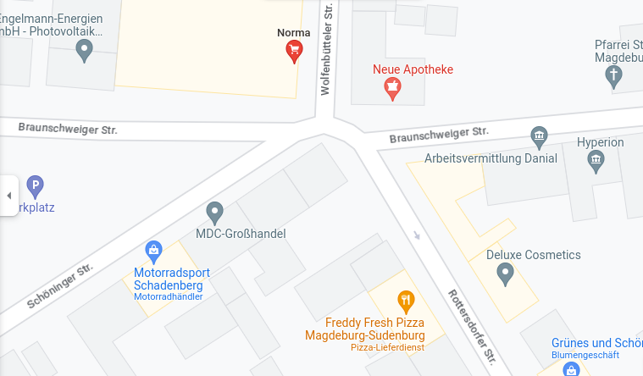
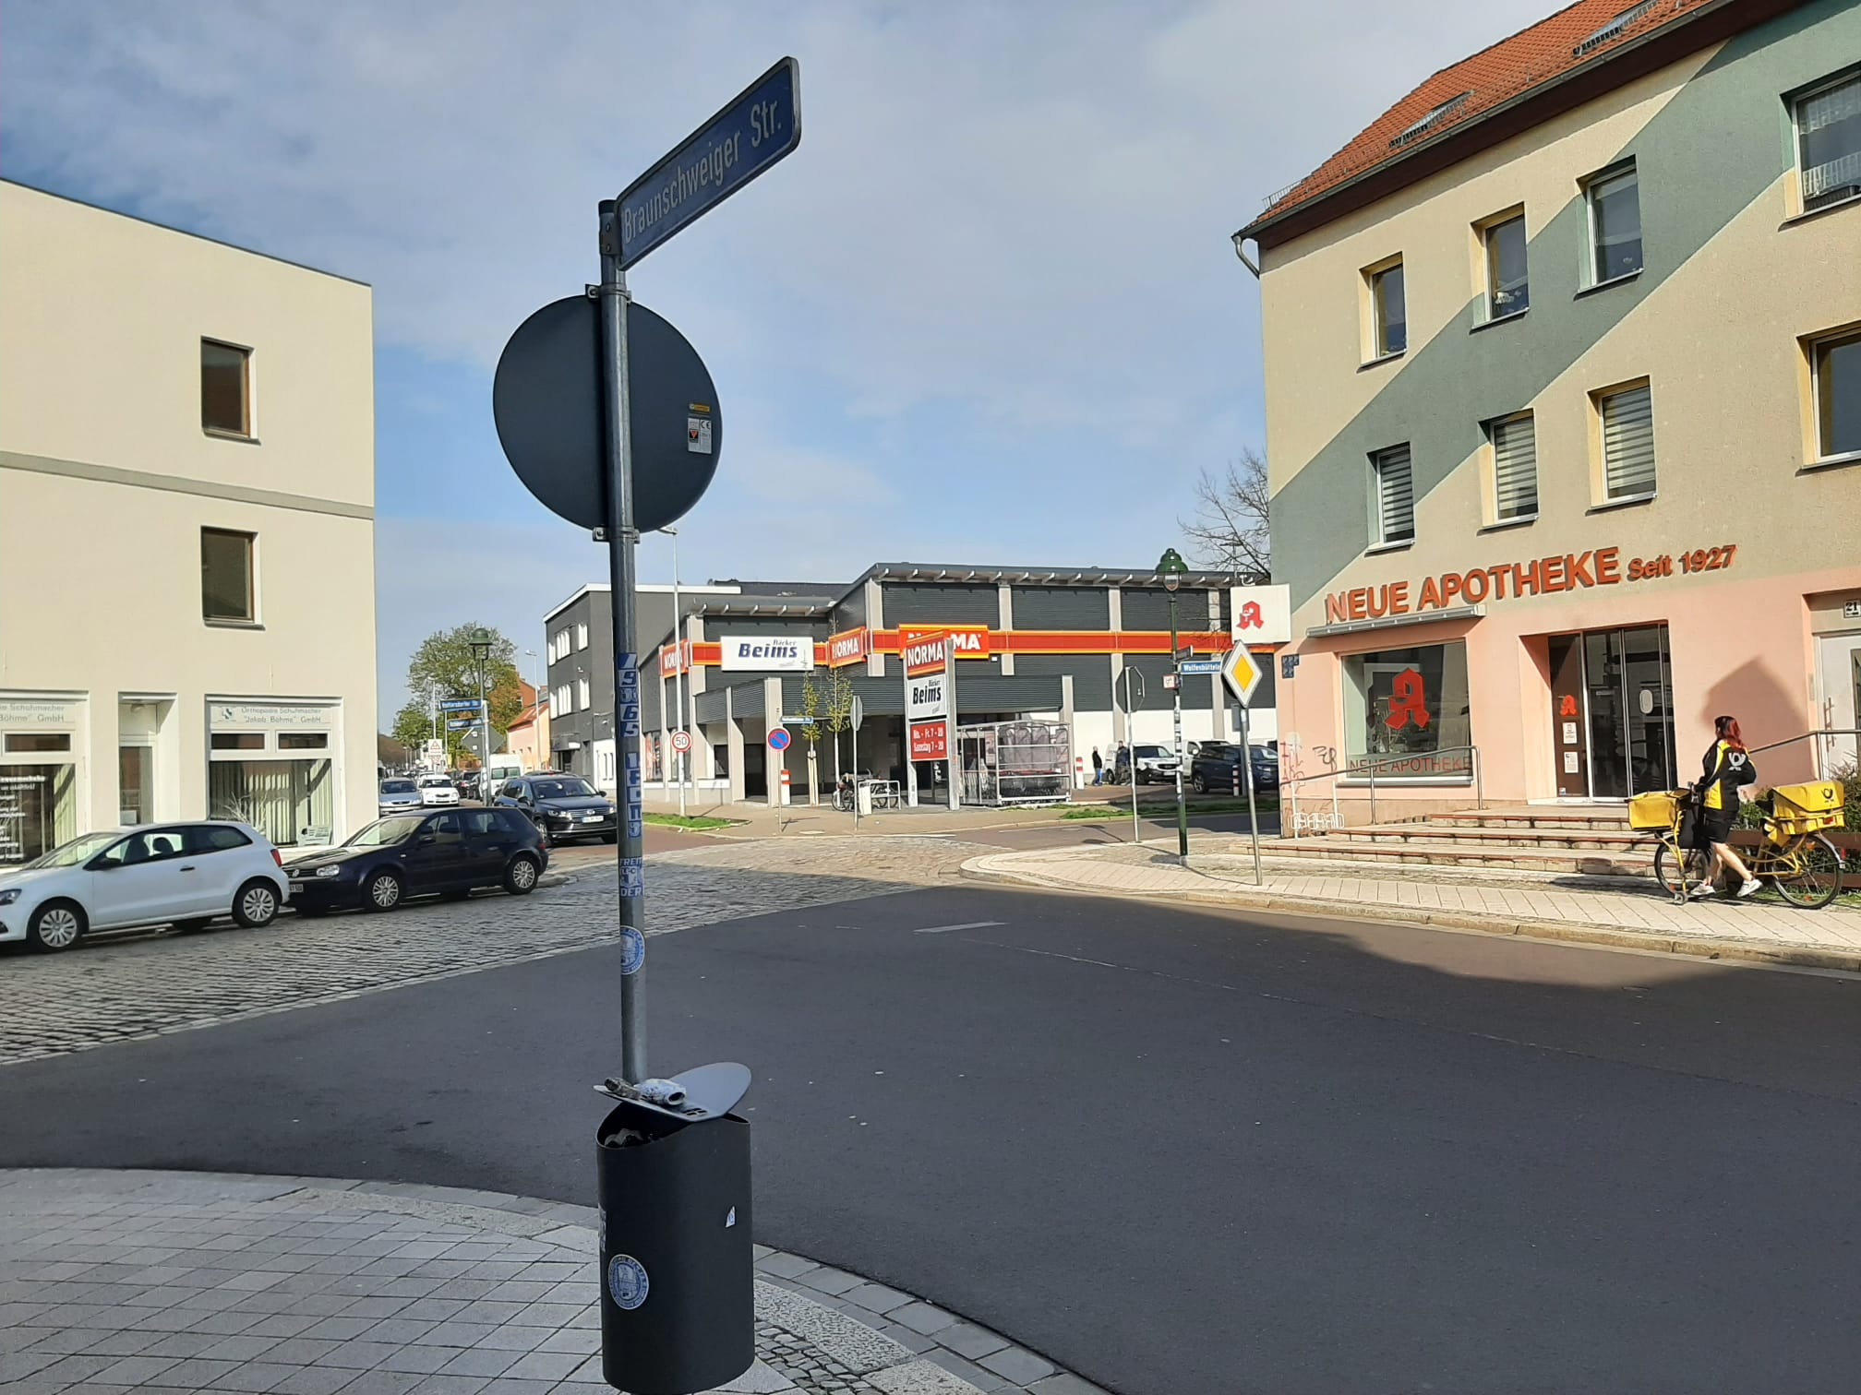
4/33
Milestone Recap
1: Team

Slide 5
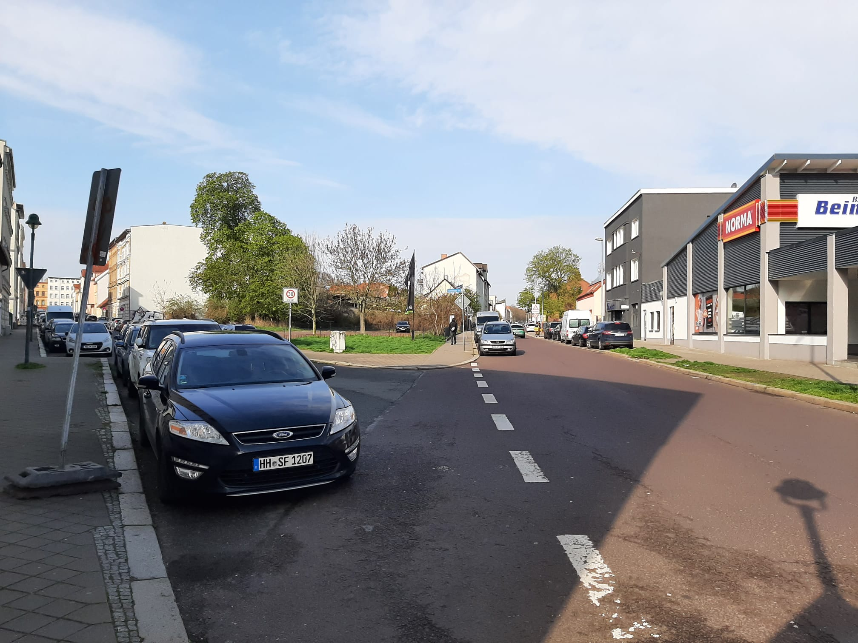
5/33
Milestone Recap
1: Team

Slide 6
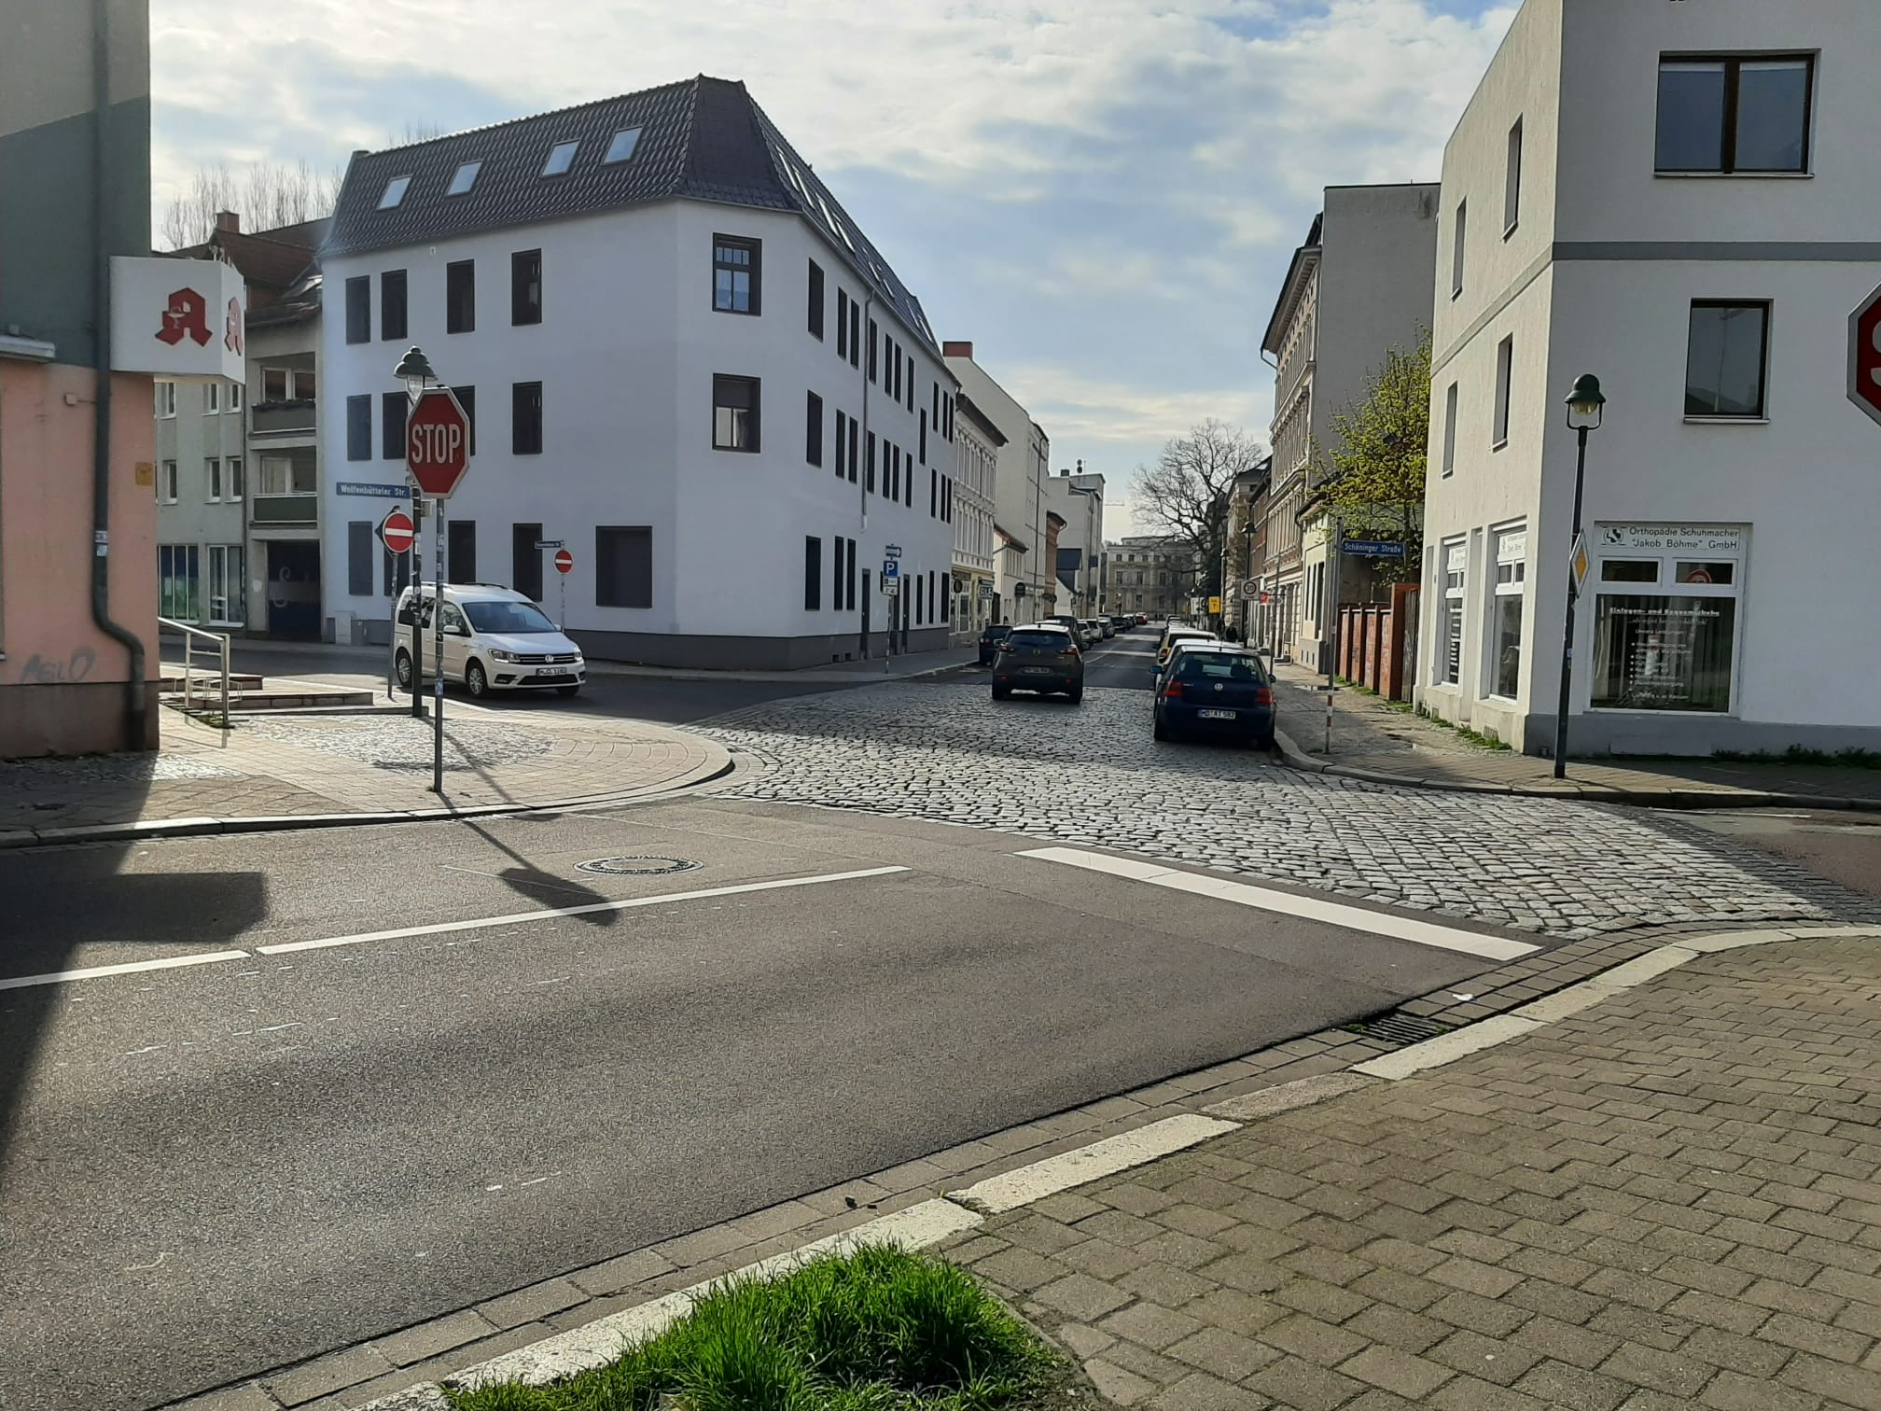
6/33
Milestone Recap
1: Team

Slide 7
7/33
Milestone Recap
1: Team
Special Challenges:
Finding a timeslot for the meeting
Coordinating the first milestone without meeting
Lack of Feedback

Slide 8
8/33
Milestone Recap
2: Project Plan
Task | Responsible | Deadline | Duration (hours)
Conceptual Model |  | 04.05.23 | 32,5
Research Petrinets on Intersections | Teja, Atif, Manu | 23.04.23 | 3
Logic Road Signs | Madeleine | 22.04.23 | 1,5
Draft Petrinet | Teja, Atif, Manu, Madeleine, Jannis | 27.04.23 | 15

Slide 9
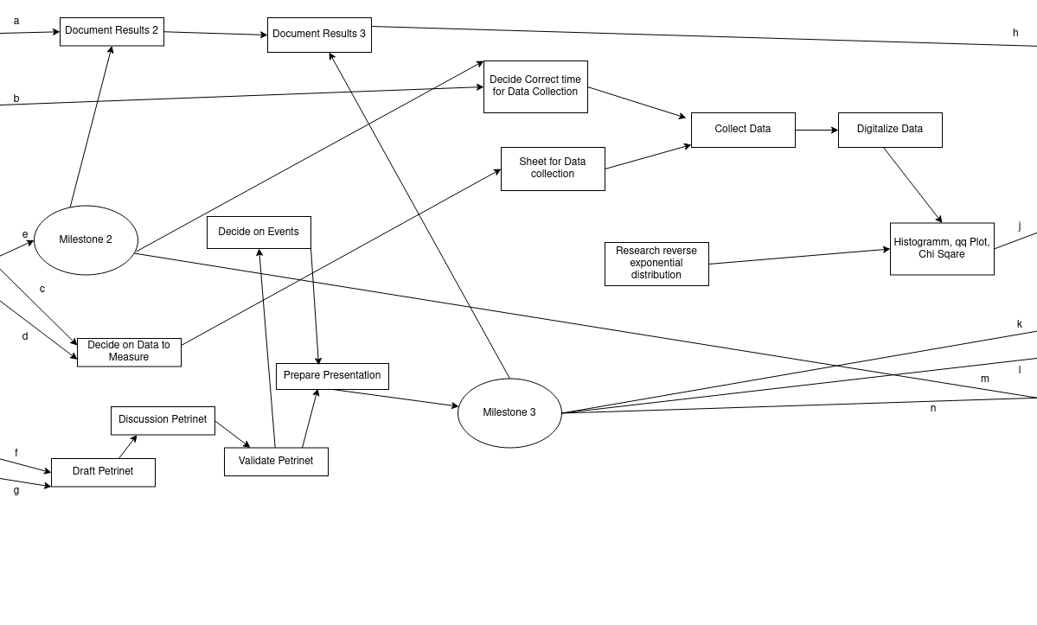
9/33
Milestone Recap
2: Project Plan

Slide 10
10/33
Milestone Recap
2: Project Plan
Special Challenges:
Time consumed for the plan
Reliability of the plan
Estimating durations and therefore costs

Slide 11
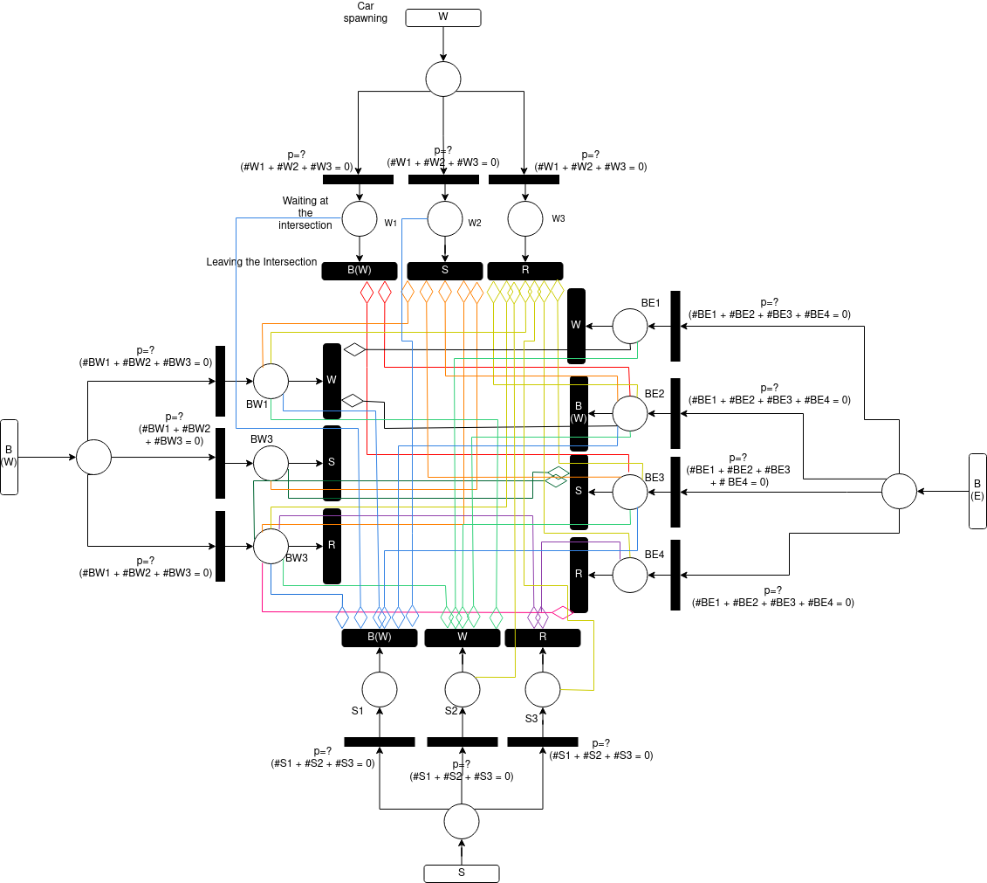
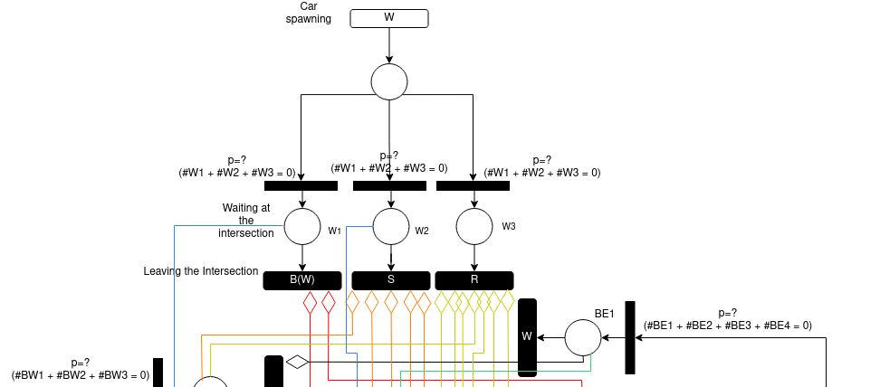
11/33
Milestone Recap
3: Conceptual Model
S → Schöninger Straße B(E) → Braunschweiger Straße East R → Rottersddorfer Straße
W → Wolfenbüttler Straße B(W) → Braunschweiger Straße West

Slide 12
12/33
Milestone Recap
3: Conceptual Model
Special Challenges:
Communication of the task at hand
Visually representing the net
Minimalism or accuracy

Slide 13
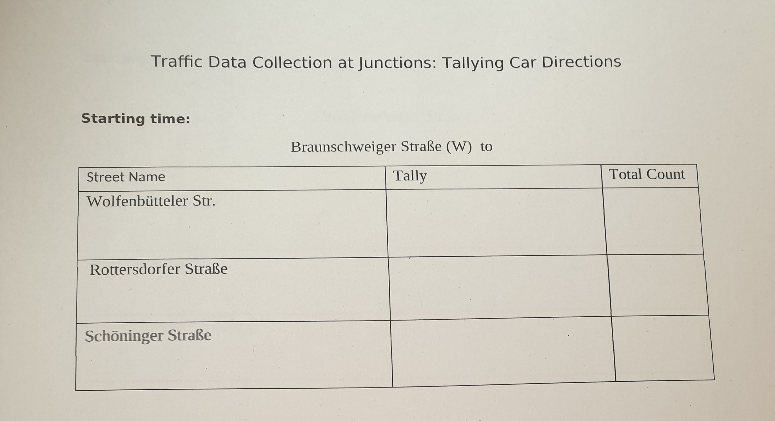
13/33
Milestone Recap
4: Data Collection
Special Challenges:
Finding a timeslot for the meeting
Coordinating the first milestone without meeting
Lack of Feedback

Slide 14
14/33
Milestone Recap
4: Data Collection
Throughput in cars per minute:
Mean | 5.36
Confidence Interval | [2.65, 8.06]
Waiting Time in seconds:
 | B(W) | B(E) | S | W
Mean | 0.01 | 0.02 | 0.09 | 0.67
Confidence Interval | [-0.01, 0.02] | [0.01, 0.03] | [-0.04, 0.22] | [0.55, 0.79]
S → Schöninger Straße B(E) → Braunschweiger Straße East R → Rottersddorfer Straße
W → Wolfenbüttler Straße B(W) → Braunschweiger Straße West

Slide 15
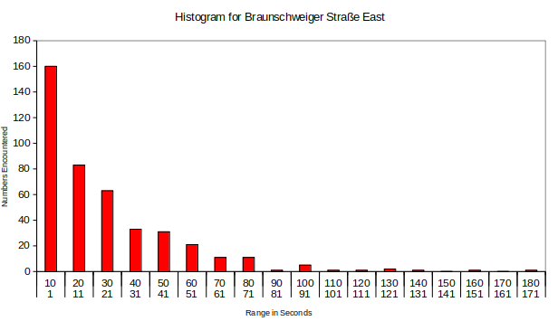
15/33
Milestone Recap
4: Data Collection
Accpeted by a Chi² Test with exponential distribution λ = 0,04, f = 3, α = 0,01

Slide 16
16/33
Milestone Recap
4: Data Collection
Special Challenges:
Redoing things for the documentation
Fitting distributions to the data
High inaccuracy for small time values resulting in awkward buckets for the Chi² Test

Slide 17
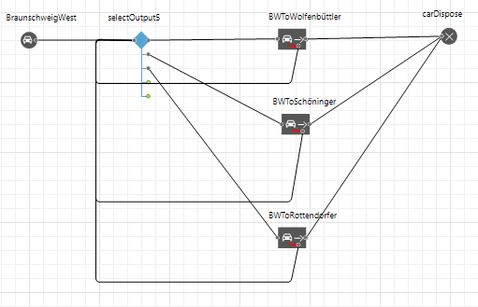
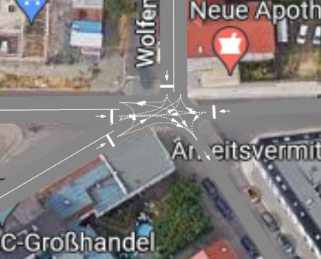
17/33
Milestone Recap
5: Anylogic Model

Slide 18
18/33
Milestone Recap
5: Anylogic Model
Special Challenges:
Debugging

Slide 19
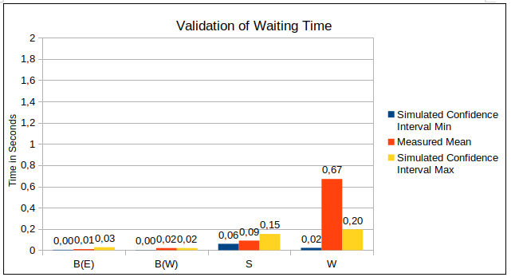
19/33
Milestone Recap
Some cars treat the stop sign at W like a yield sign, others do not
6: Validation
S → Schöninger Straße B(E) → Braunschweiger Straße East R → Rottersddorfer Straße
W → Wolfenbüttler Straße B(W) → Braunschweiger Straße West

Slide 20
20/33
Milestone Recap
6: Validation
Limitations:
Traffic Peaks only
Wolfenbüttler Straße measured higher waiting time
No pedestrians
No difference in kind of vehicle
Input of an estimated distribution

Slide 21
21/33
Milestone Recap
6: Validation
Special Challenges:
Finding out what exactly to do
Communication errors in the choice of validation
Bad choice of visualisation

Slide 22
22/33
Milestone Recap
7: Experiments
5-way roundabout
4-way roundabout
2-way traffic for Braunschweiger Straße East
2-way traffic for Rottersdorfer Straße

Slide 23
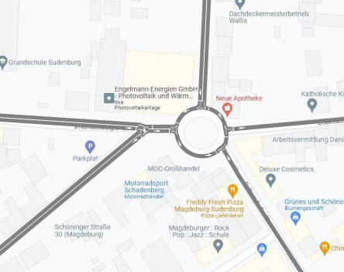
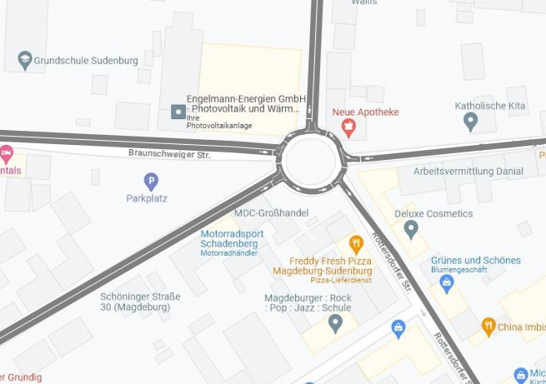
23/33
Milestone Recap
7: Experiments
Special Challenges:

Slide 24
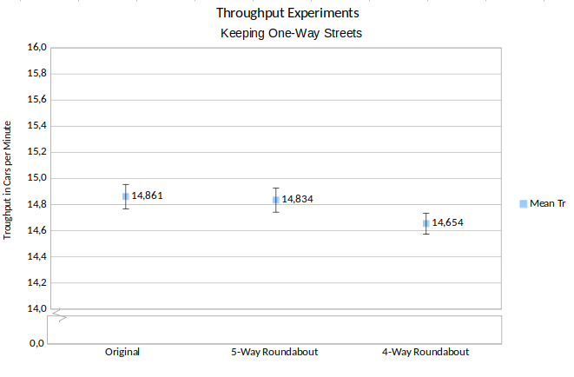
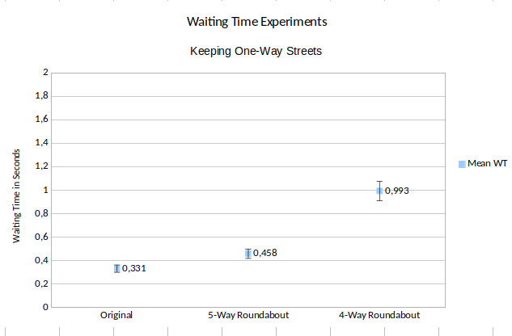
24/33
Milestone Recap
7: Experiments
Conducted with 3* the amount of current traffic

Slide 25
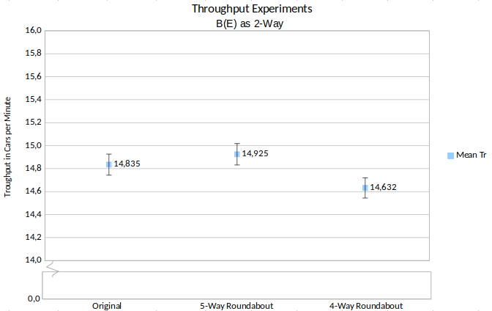
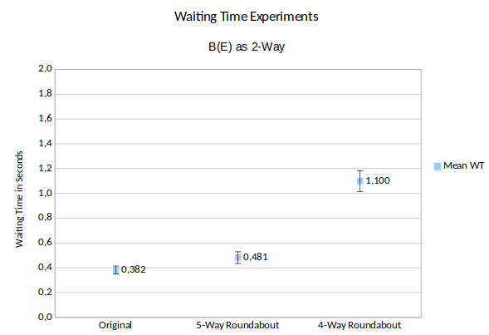
25/33
Milestone Recap
7: Experiments
Conducted with 3* the amount of current traffic
B(E) → Braunschweiger Straße East

Slide 26
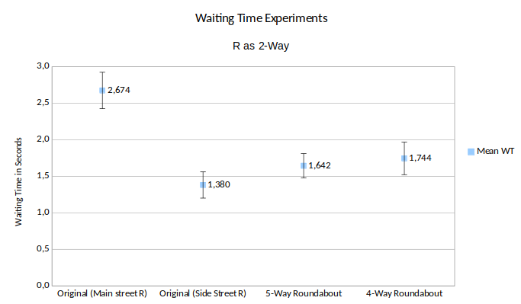
26/33
Milestone Recap
Conducted with 3* the amount of current traffic
R → Rottersdorfer Straße

Slide 27
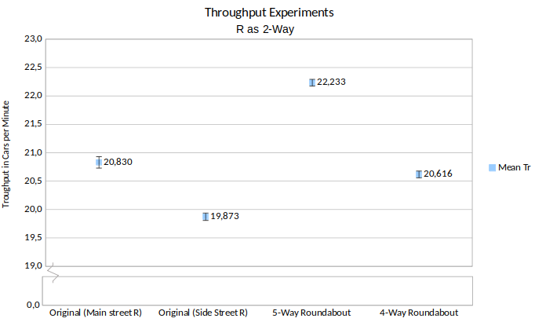
27/33
Milestone Recap
Conducted with 3* the amount of current traffic
Rottersdorfer Straße

Slide 28
28/33
Milestone Recap
7: Experiments
Special Challenges:
Finding experiments at all
Finding new ones as we used a different definition of the word

Slide 29
29/33
Recommendations
Current situation suggests no changes
    Roundabouts possibly easier to understand
    Roundabouts do not perform worse
Possible changes for increased traffic
    4-way roundabout underperforms
    5-way roundabout performs as well as current node
    5-way roundabout is versatile
    In current node Rottersdorfer Straße should not become main street

Slide 30
30/33
Cost Analysis
Show the graphics and talk about it

Slide 31
31/33
Cost Analysis
Show the graphics and talk about it

Slide 32
32/33
Cost Analysis
Show the graphics and talk about it

Slide 33
33/33
Lessons Learned
Overestimated working time for tasks
Planning is everything
If it is easy it doesn’t mean it’s fast
Communication as non-native speaker to non-native speaker
Constraints are friends
Placing the marshmallow on top

